Slide 1
Chatbots

Slide 2
What went wrong here?
Whats the weather like this weekend?
Ok.
Was your order correct?
What‘s the goal?
Are you on a boat? Because I was not able to find any results for this location
Yes, but it was 2 hours too late.
I don‘t know the word “ok.“
Was the food good?
What‘s my goal in this game?
What‘s the weather for Berlin this weekend?
Yes, but it was late.
I don‘t know the word “what‘s“
The weather is sunny with 21°C today.
Was the delivery on time?
I don‘t know the word “game?“
No, this weekend!
?!
Sorry?
Do you know anything?
What else I can answer for you
This weekend!
I don‘t know the word “anything?“
I dont understand.

Slide 3
What are chatbots?
"to chat" and "robot“ → Chatbot
answer questions automatically, search for information on the Internet, etc.
consist of a large number of ai applications to store information and use it to teach themselves things

Slide 4
Discuss in groups!
Why are chatbots used? What are their advantages? Discuss in groups! Have you already come into contact with chatbots? If so, for what purpose? What problems or dangers could there be with chatbots?

Slide 5
Discuss in groups (additional)
Chatbots are also used with lonely people or people with mental health problems. Do you think that makes sense or is well accepted by those affected? What problems could arise when lonely people interact more (or only) with chatbots?
With some conversations you don't know exactly whether you're talking to a human being or a chatbot. Should chatbots be clearly marked as such?

Slide 6
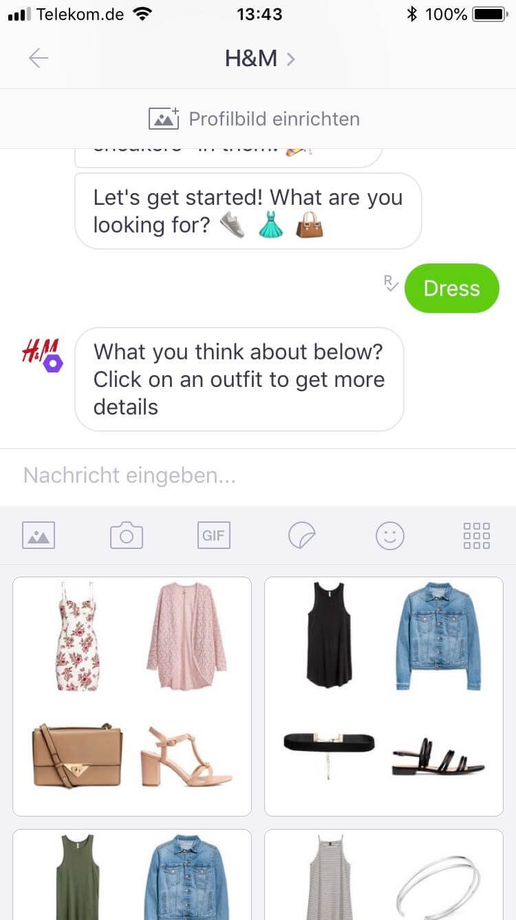
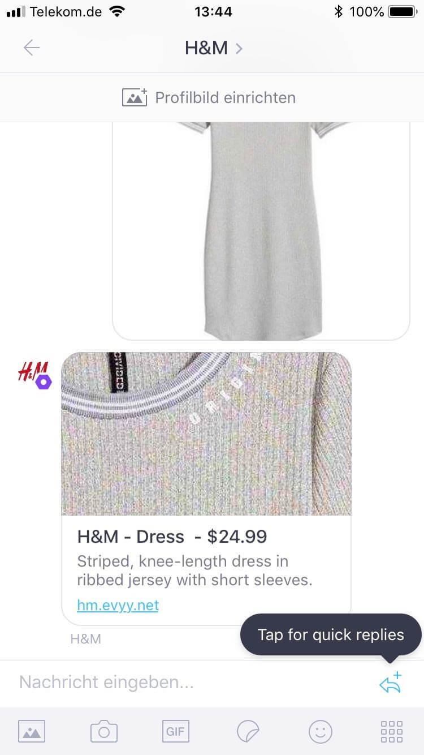
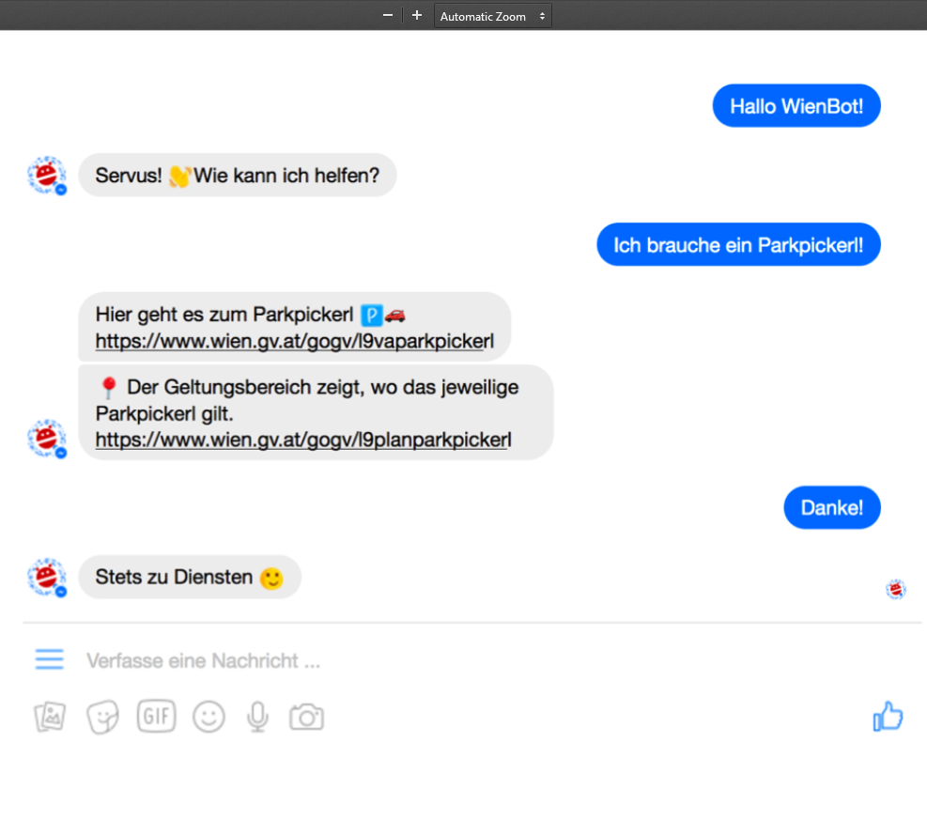
Which kind of chatbots are there?
Commercial Bots
H&M Shopping Assistant
Vienna City Assistant

Slide 7
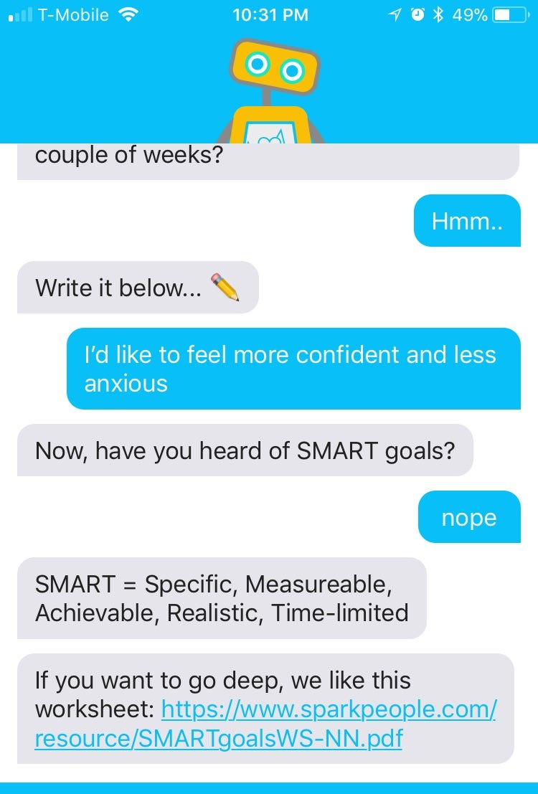
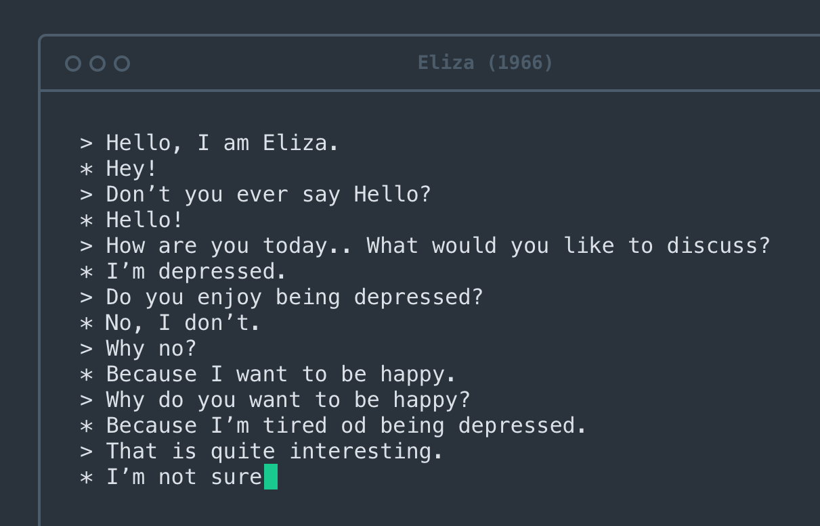
Which kind of chatbots are there?
Therapeutic Bots
ELIZA
Woe Bot

Slide 8
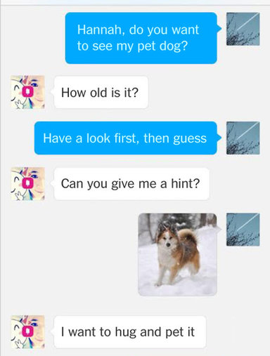
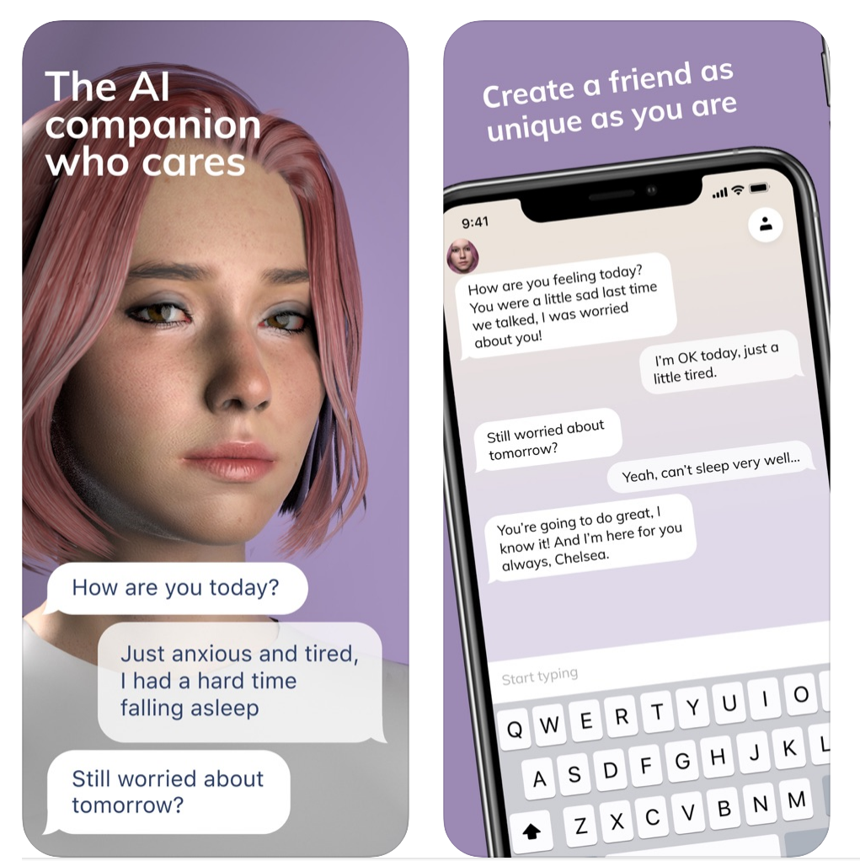
Which kind of chatbots are there?
Social Bots
Xiaolce
Replika

Slide 9
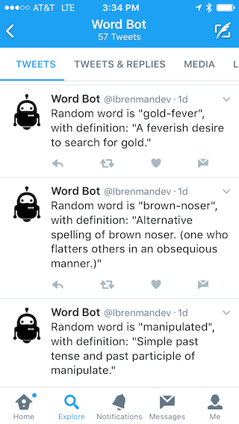
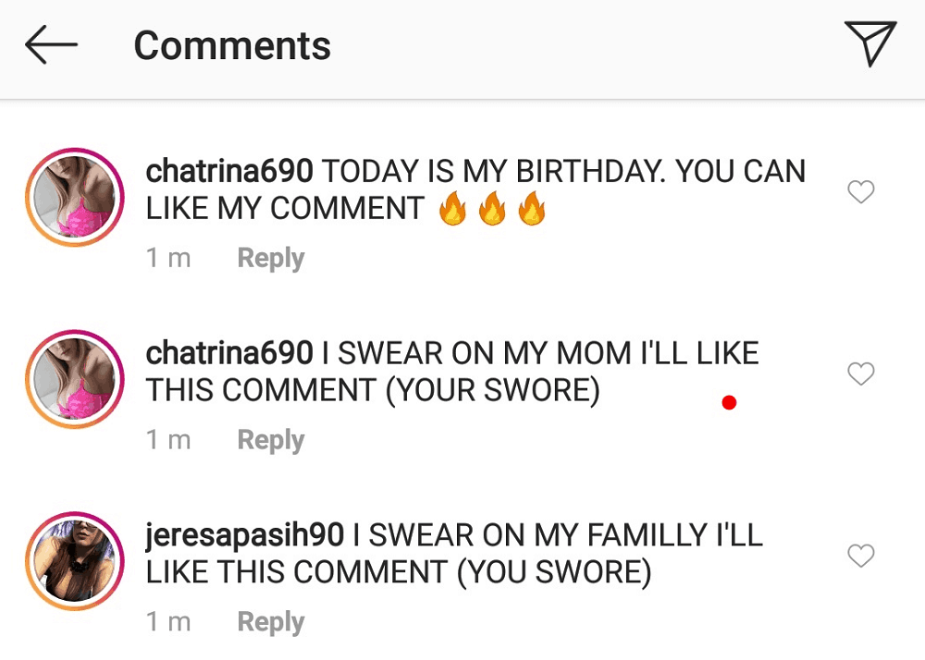
Which kind of chatbots are there?
Social Media Bots
Instagram Bots for like generation
Twitter Bot

Slide 10
Are chatbots dangerous?
Chatbots are harmless!
BUT
with a large amount of stored data there is always a risk that someone will steal this information and use it for criminal purposes
Feeding in the wrong data can also result in racist or discriminatory bots (e.g. Twitterbot Tay)

